Slide 1
TechBrains Kickoff <Year>
The moment silence is not gold …
Date: MM/DD/YYYY HH:MM-HH:MM <TZ>, <Place>
Meeting Location: <Place> Made by: GOUP
Event Planning: <Org> Host: <Host name>

Slide 2


What is GOUP?
GOUP is an idea of tech heros working abroad for:
Collaboration with new friends
Knowledge & experience sharing
Guide to use new technologies
Direct contact & advice from experienced people
AZE global brand in Open Source world

Slide 3
GOUP Collaboration Formats
02Hero 1-1.5h
1 Mentor
TechTalk
Public
TechBrains 2h
Senior tech
5m brief talk
non-public
Kiss.Conf 1-2d / 30m talks
10 Mentors
CFP selection
TechTalk
Public
https://github.com/goupaz/02hero
https://github.com/goupaz/techbrains
https://github.com/goupaz/kiss.conf
Structured and indexed data flow within community

Slide 4






Join Now!
Github: https://github.com/goupaz
Youtube: https://youtube.com/goupaz
Slack: https://goupaz.slack.com
Can find in Github even these slides!
Notes:
Other ML Tasks:
Leveraging ML to suggest opportunities with higher likelihood of success
Identifying candidates at risk of not finding a job, re-engaging before it's too late
Suggesting improvements to your resume based on job requirements

Slide 5
TechBrains

Slide 6
Motivation
Onboard Open Source community spirit …
Good Leaders talk about it …
People need your expertise, motivation, love

Slide 7
Agenda
Engineers love build stuff, solve problems
So let’s shape it:
Egoless, collaborative, competent, decentralized, scalable, fun community culture
Structured and indexed data flow within community

Slide 8
NOT IN Agenda
Politics
Religion
Immigration

Slide 9
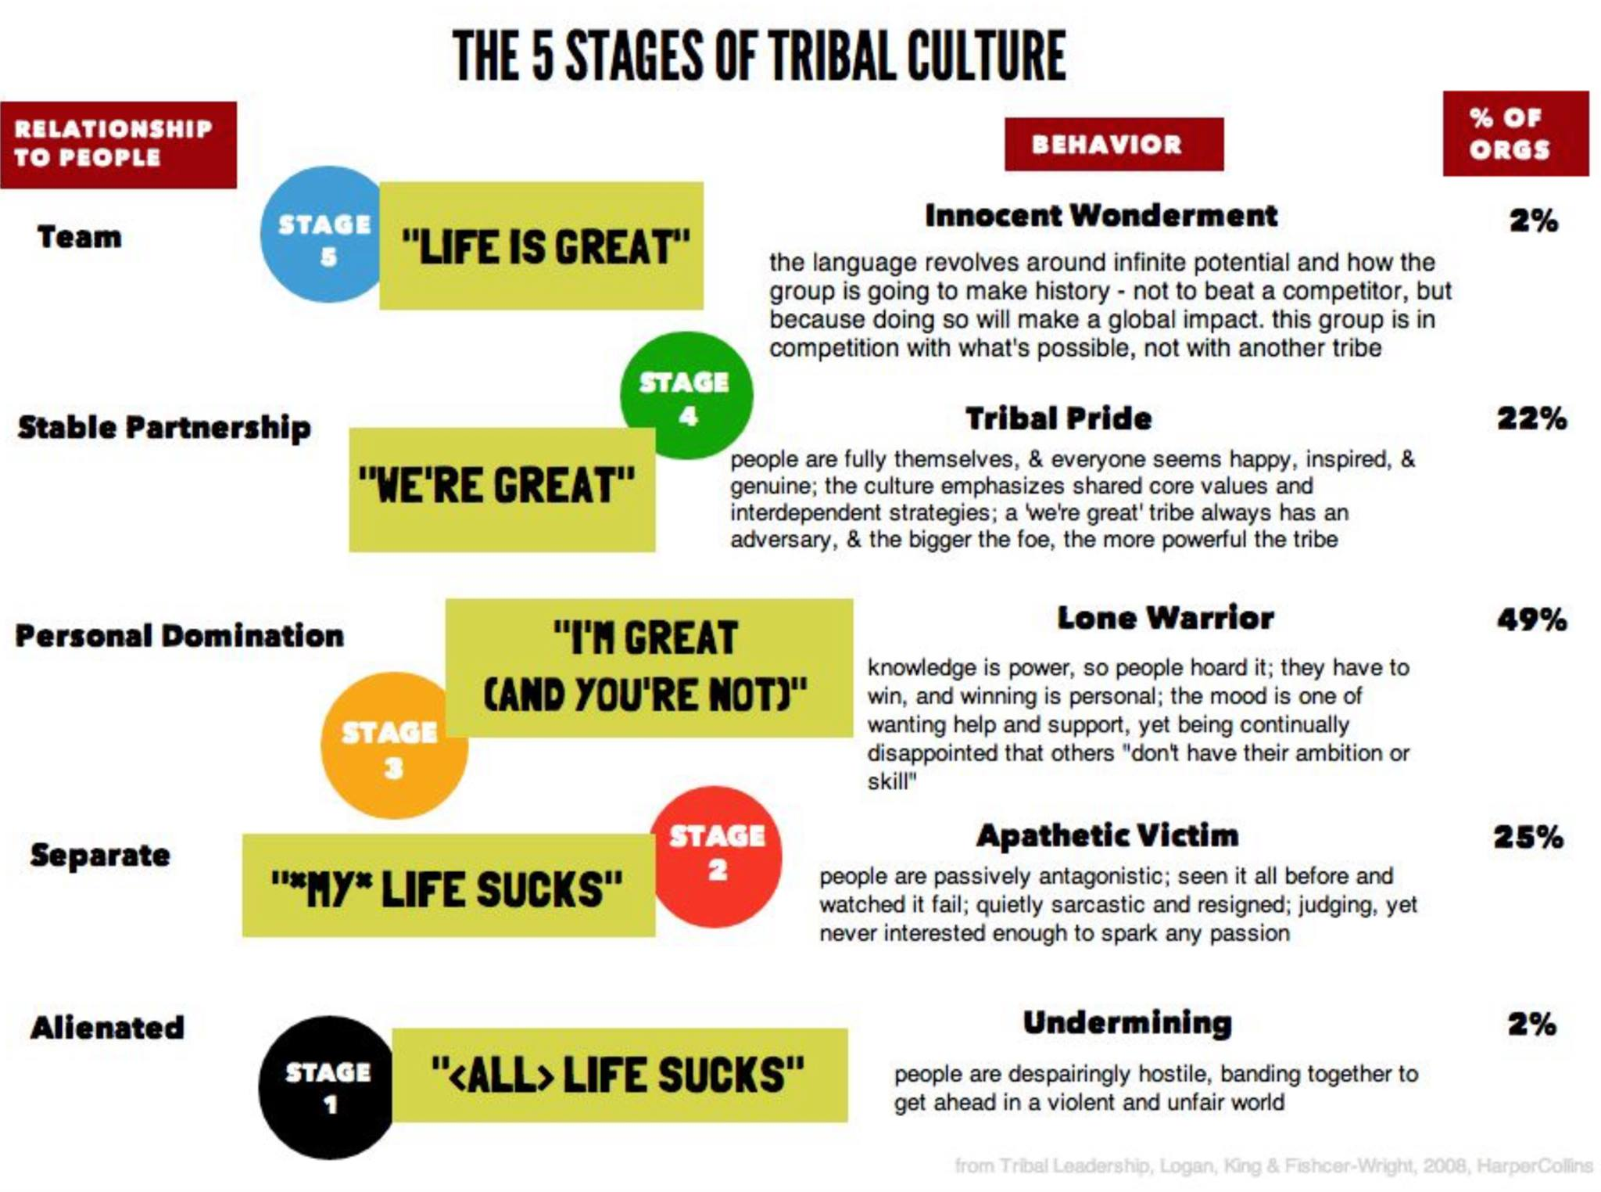
Tribal Leadership
TedTalk: https://www.youtube.com/watch?v=xTkKSJSqU-I
"Good intentions never work, you need good mechanisms to make anything happen." - Jeff Bezos

Slide 10
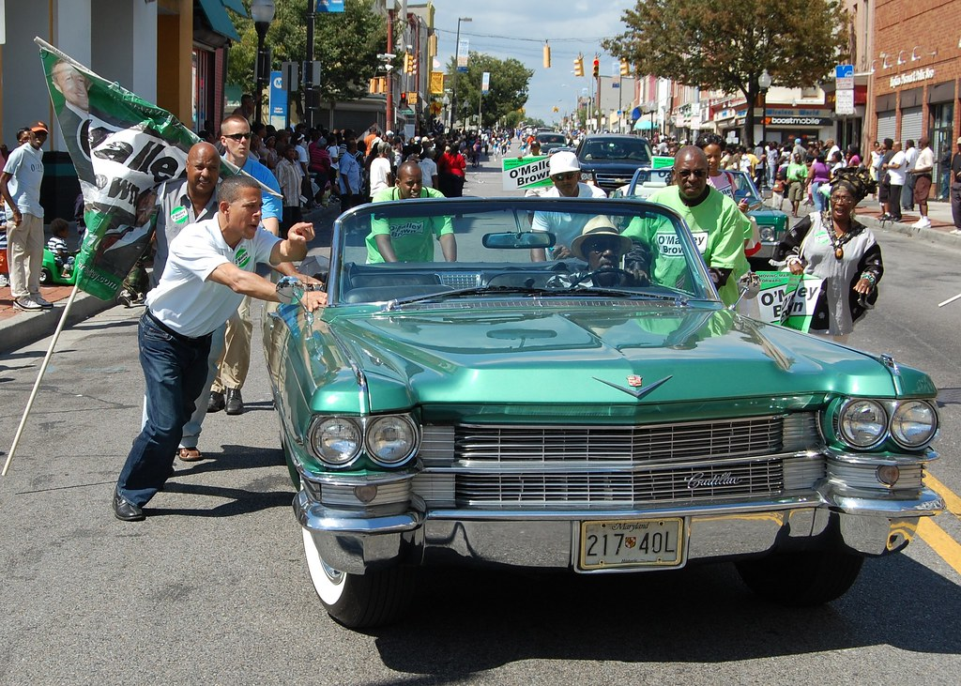
Tribal race
By pushing community in right direction, we can go faster and longer, than individual run!

Slide 11
Mechanisms
People
Process
Tools (Github, Zoom, Slack, Gmail, Youtube, NO FACEBOOK)

Slide 12

<Place Name> Techbrains Kickoff <Year>

Slide 13




































Current Companies of Community

Slide 14
Remote Speakers (via Zoom)

Slide 15
<Name>
Contact
Email: < email address >
Linkedin: < linkedin url >
Education
<Degree> <University>
Experience
Current: <Position> @ <Company name>
Past: <Company names>

Slide 16
Onsite Speakers

Slide 17
<Name>
Contact
Email: < email address >
Linkedin: < linkedin url >
Education
<Degree> <University>
Experience
Current: <Position> @ <Company name>
Past: <Company names>

Slide 18

We missed you

Slide 19
<Name> N/A
Contact
Email: < email address >
Linkedin: < linkedin url >
Education
<Degree> <University>
Experience
Current: <Position> @ <Company name>
Past: <Company names>

Slide 20

See you in <Next Year>

